Slide 1
Generation of Power from Wind Turbine
Group – 1:
Group Members:
• Md. Awsafur Rahman – 1706066
• Abdul Mukit – 1706067
• Nabila Tasnim – 1706068
• Joyita Halder – 1706069
• Tusaddique Ahmed Azfer – 1706070
• Md. Jahid Hasan Rifat – 1706071

Slide 3
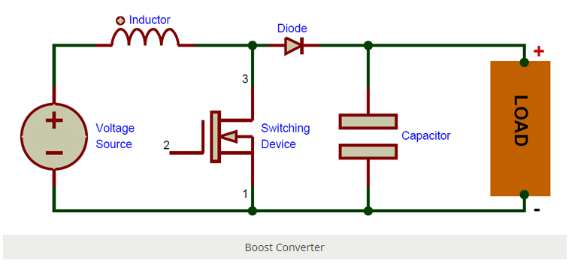
STEP – 1
Here, nothing happens. The output capacitor is charged to the input voltage minus one diode drop.
STEP – 2
Now, it’s time to turn the switch on. Our signal source goes high, turning on the MOSFET. All the current is diverted through to the MOSFET through the inductor. Note that the output capacitor stays charged since it can’t discharge through the now back-biased diode.
Step-3
The MOSFET is turned off and the current to the inductor is stopped abruptly.
The inductor now acts like a voltage source in series with the supply voltage. This means that the anode of the diode is now at a higher voltage than the cathode (remember, the cap was already charged to supply voltage in the beginning) and is forward biased.

Slide 4
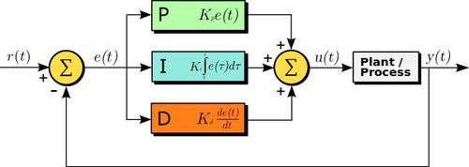

Slide 5
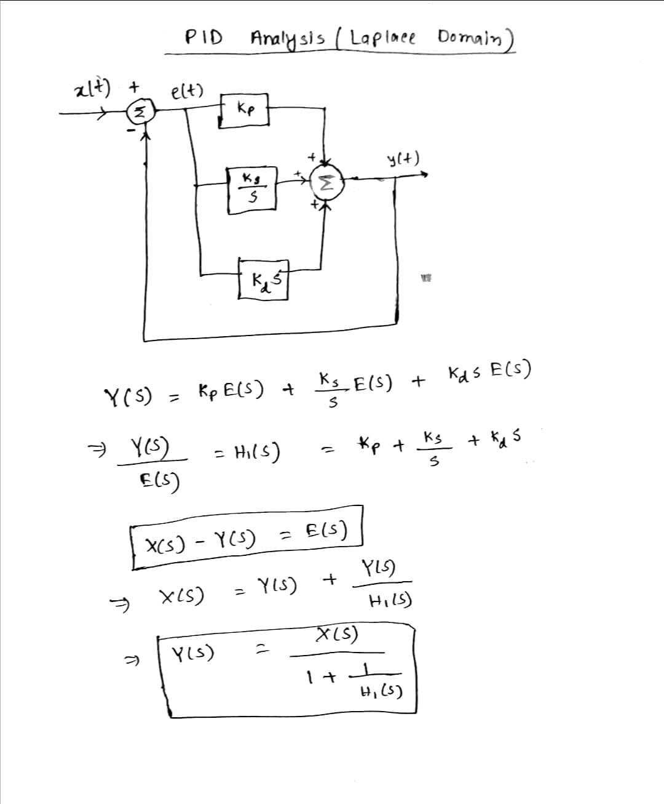

Slide 6
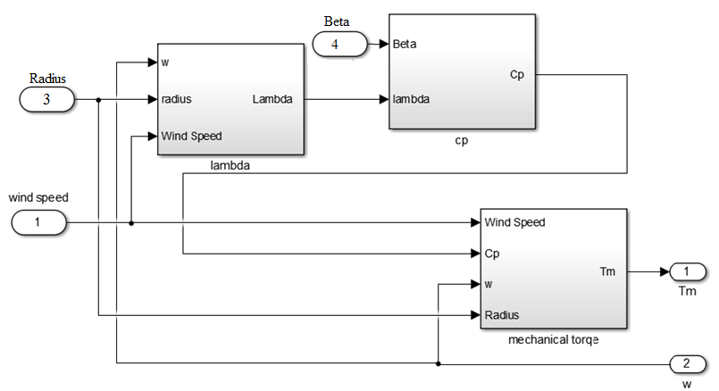

Slide 7
Ziegler-Nichols Method:
Kp = 0.45Ku
Ki = 1.2*0.45*Ku/Tu
Relational Operator:
https://youtu.be/vyCifOARicI
How to design a Boost Converter:
https://youtu.be/CzhqLeyGNf0

Slide 8
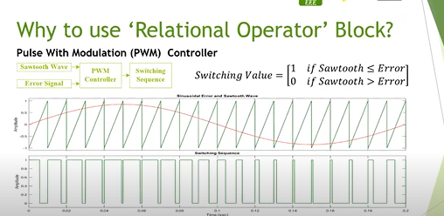

Slide 9
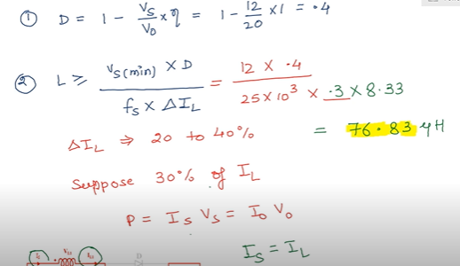
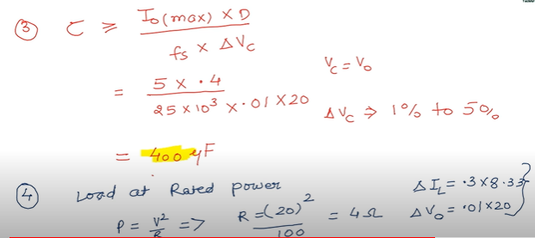
Design of Boost Chopper:

Slide 11
Tasks
Input to Wind Turbine and Boost Chopper – Nabila
3-phase generation from PMSG – Awsaf
3-phase to DC (3 phase rectifier) – Jahid
DC to 3-phase ( 50 Hz) [PWM Inverter] – Mukit
Load design ( AC, DC, grid) – Azfer
GUI - Joyita

